Slide 1
Finite-State Automata and Project 1
CS 236
Fall 2023

Slide 2
Overview and Due
Finite state automata
Elements of state machine definition
Parallel and max algorithm for project 1
Due
HW 3 due tomorrow
HW 4 due Wednesday
Project 1 due Thursday, Sept 28
You can start project 1 today

Slide 3
An error on HW 3
The description of problem 7 was incomplete and the correct answer has a typo. It’s the question that says
I’ve added another attempt if you’ve already taken two and need a third. Sorry
Which Regular Expression best matches the following description? Accepts any string that contains any number of a's or any number of b's followed by either one or more a's or one or more b's. It also accepts any string that starts with a c. The vocabulary is V = {a,b,c}.

Slide 4
Running a Finite State Machine
Traces

Slide 5
Project 1: FSM for “Rules” Datalog keyword
s₀
Let’s do a trace on two different inputs
R , λ
not R , fail
s₁
not u , fail
u , λ
s₂
not l , fail
s_{fail}
l , λ
not e , fail
anythihg , λ
s₃
not s , fail
e , λ
anything , oops
s₄
s , RULES
s₅

Slide 6
Project 1: FSM for “Rules” Datalog keyword
s₀
Let’s do a trace on two different inputs
R , λ
not R , fail
Input string
Output
s₁
not u , fail
Rules
u , λ
s₂
not l , fail
s_{fail}
l , λ
not e , fail
anythihg , λ
s₃
not s , fail
e , λ
anything , oops
s₄
s , RULES
s₅

Slide 7
Project 1: FSM for “Rules” Datalog keyword
s₀
Let’s do a trace on two different inputs
R , λ
not R , fail
Input string
Output
s₁
not u , fail
Rules
u , λ
s₂
not l , fail
s_{fail}
l , λ
not e , fail
anythihg , λ
s₃
not s , fail
e , λ
anything , oops
s₄
s , RULES
s₅

Slide 8
Project 1: FSM for “Rules” Datalog keyword
s₀
Let’s do a trace on two different inputs
R , λ
not R , fail
Input string
Output
s₁
not u , fail
Rules
u , λ
s₂
not l , fail
s_{fail}
l , λ
not e , fail
anythihg , λ
s₃
not s , fail
e , λ
anything , oops
s₄
s , RULES
s₅

Slide 9
Project 1: FSM for “Rules” Datalog keyword
s₀
Let’s do a trace on two different inputs
R , λ
not R , fail
Input string
Output
s₁
not u , fail
Rules
u , λ
s₂
not l , fail
s_{fail}
l , λ
not e , fail
anythihg , λ
s₃
not s , fail
e , λ
anything , oops
s₄
s , RULES
s₅

Slide 10
Project 1: FSM for “Rules” Datalog keyword
s₀
Let’s do a trace on two different inputs
R , λ
not R , fail
Input string
Output
s₁
not u , fail
Rules
u , λ
s₂
not l , fail
s_{fail}
l , λ
not e , fail
anythihg , λ
s₃
not s , fail
e , λ
anything , oops
s₄
s , RULES
s₅

Slide 11
Project 1: FSM for “Rules” Datalog keyword
s₀
Let’s do a trace on two different inputs
R , λ
not R , fail
Input string
Output
s₁
not u , fail
Rules
λ
u , λ
s₂
not l , fail
s_{fail}
l , λ
not e , fail
anythihg , λ
s₃
not s , fail
e , λ
anything , oops
s₄
s , RULES
s₅

Slide 12
Project 1: FSM for “Rules” Datalog keyword
s₀
Let’s do a trace on two different inputs
R , λ
not R , fail
Input string
Output
s₁
not u , fail
Rules
λ
u , λ
s₂
not l , fail
s_{fail}
l , λ
not e , fail
anythihg , λ
s₃
not s , fail
e , λ
anything , oops
s₄
s , RULES
s₅

Slide 13
Project 1: FSM for “Rules” Datalog keyword
s₀
Let’s do a trace on two different inputs
R , λ
not R , fail
Input string
Output
s₁
not u , fail
Rules
λ
u , λ
s₂
not l , fail
s_{fail}
l , λ
not e , fail
anythihg , λ
s₃
not s , fail
e , λ
anything , oops
s₄
s , RULES
s₅

Slide 14
Project 1: FSM for “Rules” Datalog keyword
s₀
Let’s do a trace on two different inputs
R , λ
not R , fail
Input string
Output
s₁
not u , fail
Rules
λ
u , λ
s₂
not l , fail
s_{fail}
l , λ
not e , fail
anythihg , λ
s₃
not s , fail
e , λ
anything , oops
s₄
s , RULES
s₅

Slide 15
Project 1: FSM for “Rules” Datalog keyword
s₀
Let’s do a trace on two different inputs
R , λ
not R , fail
Input string
Output
s₁
not u , fail
Rules
λ
u , λ
s₂
not l , fail
s_{fail}
l , λ
not e , fail
anythihg , λ
s₃
not s , fail
e , λ
anything , oops
s₄
s , RULES
s₅

Slide 16
Project 1: FSM for “Rules” Datalog keyword
s₀
Let’s do a trace on two different inputs
R , λ
not R , fail
Input string
Output
s₁
not u , fail
Rules
RULES
u , λ
s₂
not l , fail
s_{fail}
l , λ
not e , fail
anythihg , λ
s₃
not s , fail
e , λ
anything , oops
s₄
s , RULES
s₅

Slide 17
Another input

Slide 18
Project 1: FSM for “Rules” Datalog keyword
s₀
Let’s do a trace on two different inputs
R , λ
not R , fail
Input string
Output
s₁
not u , fail
Rust
λ
u , λ
s₂
not l , fail
s_{fail}
l , λ
not e , fail
anythihg , λ
s₃
not s , fail
e , λ
anything , oops
s₄
s , RULES
s₅

Slide 19
Project 1: FSM for “Rules” Datalog keyword
s₀
Let’s do a trace on two different inputs
R , λ
not R , fail
Input string
Output
s₁
not u , fail
Rust
λ
u , λ
s₂
not l , fail
s_{fail}
l , λ
not e , fail
anythihg , λ
s₃
not s , fail
e , λ
anything , oops
s₄
s , RULES
s₅

Slide 20
Project 1: FSM for “Rules” Datalog keyword
s₀
Let’s do a trace on two different inputs
R , λ
not R , fail
Input string
Output
s₁
not u , fail
Rust
fail
u , λ
s₂
not l , fail
s_{fail}
l , λ
not e , fail
anythihg , λ
s₃
not s , fail
e , λ
anything , oops
s₄
s , RULES
s₅

Slide 21
Finite State Automaton
A cousin of a finite state machine

Slide 22
Formal definition (def 3 in §13.3.3)
A finite state automaton (FSA) is a tuple (S, I, s_{o}, F, f)
Finite set of states: S
Set of input characters: I
Start state: s_{o}
Set of final or accept states: F
Transition function: f: S ⨉ I ⟶ S

Slide 23
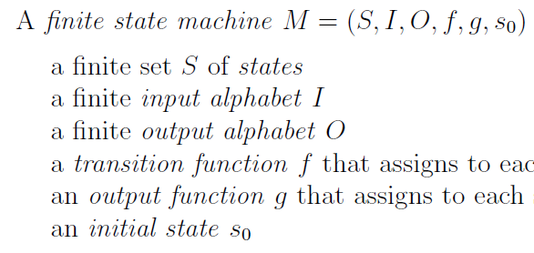
Formal definition (def 3 in §13.3.3)
A finite state automaton (FSA) is a tuple (S, I, s_{o}, F, f)
Finite set of states: S
Set of input characters: I
Start state: s_{o}
Set of final or accept states: F
Transition function: f: S ⨉ I ⟶ S

Slide 24
Formal definition (def 3 in §13.3.3)
A finite state automaton (FSA) is a tuple (S, I, s_{o}, F, f)
Finite set of states: S
Set of input characters: I
Start state: s_{o}
Set of final or accept states: F
Transition function: f: S ⨉ I ⟶ S
What’s the same?

Slide 25
Formal definition (def 3 in §13.3.3)
A finite state automaton (FSA) is a tuple (S, I, s_{o}, F, f)
Finite set of states: S
Set of input characters: I
Start state: s_{o}
Set of final or accept states: F
Transition function: f: S ⨉ I ⟶ S
What’s different?

Slide 26
Example FSA
Tuple (S, I, s_{o}, F, f)
Finite set of states: S
Set of input characters: I
Start state: s_{o}
Set of final or accept states: F
Transition function: f: S ⨉ I ⟶ S

Slide 27
Example FSA
Tuple (S, I, s_{o}, F, f)
Finite set of states: S
Set of input characters: I
Start state: s_{o}
Set of final or accept states: F
Transition function: f: S ⨉ I ⟶ S
A double circle represents an accept state

Slide 28
Example FSA
Tuple (S, I, s_{o}, F, f)
Finite set of states: S
Set of input characters: I
Start state: s_{o}
Set of final or accept states: F
Transition function: f: S ⨉ I ⟶ S
Only output is “accept” or “not accept”

Slide 29
Project 1: FSA for “Rules” Datalog keyword
Input string
Output
Rules

Slide 30
Project 1: FSA for “Rules” Datalog keyword
Input string
Output
Rust

Slide 31
Regular Expressions and Finite State Automata

Slide 32
Two pattern manager tools
Regular Expressions
Finite State Automata
Pattern
Pattern
Regular Expression
Finite State Automaton
Specific
string
All strings matching
that pattern
Does that specific
string match that pattern

Slide 33
Practice with examples from today’s HW
Regular Expression
Finite State Automaton
Finite set of states: S
Set of input characters:
Start state: s_{o}
Set of final or accept states: F
Transition function: f: S ⨉ I ⟶ S

Slide 34
Practice with examples from today’s HW
Regular Expression
Finite State Automaton
Finite set of states: S
Set of input characters:
Start state: s_{o}
Set of final or accept states: F
Transition function: f: S ⨉ I ⟶ S
Discuss:
Accept states
Error state

Slide 35
Practice with examples from today’s HW
Regular Expression
Finite State Automaton
Finite set of states: S
Set of input characters:
Start state: s_{o}
Set of final or accept states: F
Transition function: f: S ⨉ I ⟶ S

Slide 36
Practice with examples from today’s HW
Regular Expression
Finite State Automaton
Finite set of states: S
Set of input characters:
Start state: s_{o}
Set of final or accept states: F
Transition function: f: S ⨉ I ⟶ S

Slide 37
Practice with examples from today’s HW
Regular Expression
Finite State Automaton
Finite set of states: S
Set of input characters:
Start state: s_{o}
Set of final or accept states: F
Transition function: f: S ⨉ I ⟶ S

Slide 38
Two Project 1 Design Approaches

Slide 39
Design a finite state machine that outputs “COLON-DASH” only if the input string is “:-”
Design a finite state automaton that succeeds only if the input string is “:-”
Pattern
Pattern
Finite State Machine
Finite State Automaton
Specific
string
Specific
string
Output the
pattern name
Does that specific
string match that pattern

Slide 40
Design a finite state machine that outputs “COLON-DASH” only if the input string is “:-”
Design a finite state automaton that succeeds only if the input string is “:-”

Slide 41
Design a finite state machine that outputs “COLON-DASH” only if the input string is “:-”
Design a finite state automaton that succeeds only if the input string is “:-”
-, COLON-DASH
s₀
: , λ
s₂
s₁
not : , fail
not - , fail
anything, λ
s_{fail}
anything, λ

Slide 42
Design a finite state machine that outputs “COLON-DASH” only if the input string is “:-”
Design a finite state automaton that succeeds only if the input string is “:-”
-, COLON-DASH
s₀
: , λ
s₂
s₁
not : , fail
not - , fail
anything, λ
s_{fail}
anything, λ

Slide 43
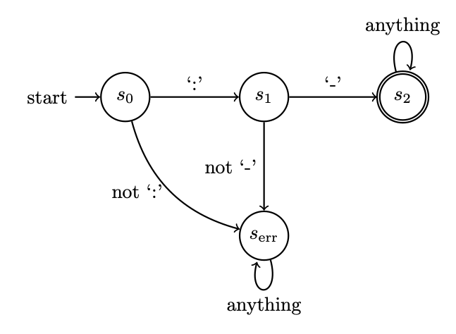
Design a finite state machine that outputs “COLON-DASH” only if the input string is “:-”
Design a finite state automaton that succeeds only if the input string is “:-”
-, COLON-DASH
s₀
: , λ
s₂
s₁
not : , fail
not - , fail
anything, λ
s_{fail}
anything, λ

Slide 44
Project 1 and FSAs

Slide 45
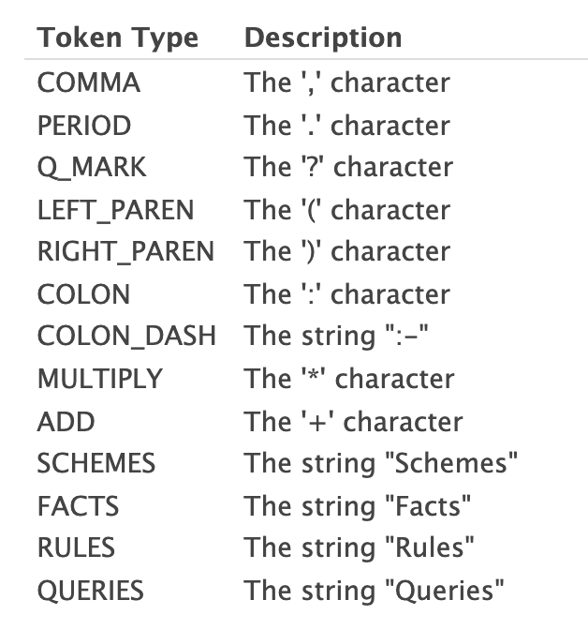
Datalog
Program
Lexer
Output
Schemes:
f(A,B)
g(C,D)
r(E,F)
Facts:
f('1','2').
f('4','3').
g('3','2').
r('1','4').
r('2','5').
r('3','5').
r('4','1').
Rules:
r(A,B) :- f(A,X),g(B,X).
f(C,D) :- r(D,C).
g(E,F) :- f(E,X),r(X,F).
Queries:
f('3',Z)?
r(Y,'3')?
f(W,X)?
(SCHEMES,"Schemes",1)
(COLON,":",1)
(ID,"f",2)
(LEFT_PAREN,"(",2)
(ID,"A",2)
(COMMA,",",2)
(ID,"B",2)
(RIGHT_PAREN,")",2)
(ID,"g",3)
(LEFT_PAREN,"(",3)
(ID,"C",3)
(COMMA,",",3)
(ID,"D",3)
(RIGHT_PAREN,")",3)
(ID,"r",4)
(LEFT_PAREN,"(",4)
(ID,"E",4)
(COMMA,",",4)
(ID,"F",4)
(RIGHT_PAREN,")",4)
(FACTS,"Facts",6)
(COLON,":",6)
(ID,"f",7)
(LEFT_PAREN,"(",7)
(STRING,"'1'",7)
(COMMA,",",7)
(STRING,"'2'",7)
(RIGHT_PAREN,")",7)
(PERIOD,".",7)
(ID,"f",8)
(LEFT_PAREN,"(",8)
(STRING,"'4'",8)
(COMMA,",",8)
(STRING,"'3'",8)
(RIGHT_PAREN,")",8)
(PERIOD,".",8)
(ID,"g",9)
(LEFT_PAREN,"(",9)
(STRING,"'3'",9)
Datalog program
Lexer
tokens

Slide 46
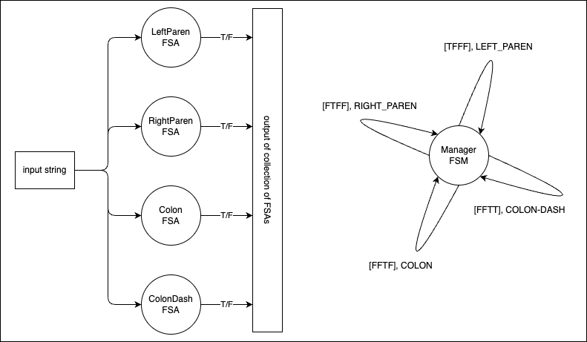
Lexer
The Lexer is made up of a set of FSAs,
one for each Datalog program pattern

Slide 47
Lexer
Schemes:
mike0(A,B)
g(C,D)
Facts:
mike0('1','2').
mike0('4','3').
g('3','2').
Rules:
Queries:
mike0('3',Z)?
g(‘3’,Z)?
Lexer
tokens
The input to the Lexer is a string.
Read the Datalog program into a string
Step each FSA through the Datalog string

Slide 48
Lexer
An example Datalog program that can be Lexed but won’t run (see Project 2)
:
:-
(
)
mike0
Lexer
tokens
The input to the Lexer is a string.
Read the Datalog program into a string
Step each FSA through the Datalog string

Slide 49
Lexer
The first character in the string
:
:-
(
)
mike0
Lexer
tokens
The input to the Lexer is a string.
Read the Datalog program into a string
Step each FSA through the Datalog string

Slide 50
Lexer
The first character in the string
:
:-
(
)
mike0
Lexer
tokens
Run FSA until it succeeds or fails

Slide 51
Lexer
The first character in the string
:
:-
(
)
mike0
Lexer
tokens
Run FSA until it succeeds or fails

Slide 52
Lexer
The first character in the string
:
:-
(
)
mike0
Lexer
tokens
Run FSA until it succeeds or fails
Rewind to start of string and run next FSA

Slide 53
Lexer
The first character in the string
:
:-
(
)
mike0
Lexer
tokens
Run FSA until it succeeds or fails
Rewind to start of string and run next FSA
Repeat

Slide 54
Lexer
The first character in the string
:
:-
(
)
mike0
Lexer
tokens
Run FSA until it succeeds or fails
Rewind to start of string and run next FSA
Repeat

Slide 55
Lexer
The first character in the string
:
:-
(
)
mike0
Lexer
tokens
Look at outputs from all FSAs
Choose which Token is correct

Slide 56
Lexer
Look at outputs from all FSAs
Choose which Token is correct

Slide 57
Lexer
The first character in the string
:
:-
(
)
mike0
Lexer
COLON
Output correct token

Slide 58
Lexer
The first character in the string
:
:-
(
)
mike0
Lexer
COLON
Output correct token
Reset all FSAs

Slide 59
Lexer
The first character in the string
:
:-
(
)
mike0
Lexer
COLON
Output correct token
Reset all FSAs
Advance to next part of string

Slide 60
Lexer
The first character in the string
:
:-
(
)
mike0
Lexer
tokens
Run FSA until it succeeds or fails
Rewind to start of string and run next FSA
Repeat

Slide 61
Lexer
Look at outputs from all FSAs
Choose which Token is correct

Slide 62
Lexer
The first character in the string
:
:-
(
)
mike0
Lexer
COLON
COLON-DASH
Output correct token
Reset all FSAs
Advance to next part of string

Slide 63
Implementing FSAs
See Jupyter notebook tutorials
FSA_code_example
Multiple_FSAS_using_inheritance
Project1_example_managing_multiple_FSAs

